Slide 1
Ovarian Cancer Action – understanding effectiveness of washroom campaign November 2015
Shoreditch Stables
138 Kingsland Road
London E2 8DY
info@roiteam.co.uk
www.roiteam.co.uk

Slide 2
Research Objectives
Build understanding of the delivery of communication campaign by Ovarian Cancer Action
Establish levels of awareness and understanding
Investigate preferred approach/location for communication of these messages
Measure effectiveness of messages delivered, and consequent propensity to act

Slide 3
Research Approach
ROI Team carried out a survey of female visitors at two shopping centres where the autumn poster campaign promoted by Ovarian Cancer Action was displayed. Fieldwork took place on the following days:
Hammersmith Broadway Centre, Monday October 5th (101 interviews)
Liberty Centre, Romford, Friday October 9th (118 interviews)
We used a team of Supervisor plus 3 female interviewers at both centres, working from 10am to 5.30pm (Hammersmith) and to 5pm in Romford
Visitors appearing to leave the washrooms were approached for interview on a ‘next available’ basis, which we believe replicated the profile of visitors to the centre, including their ethnic profile
Everyone agreeing was taken through the short standard questionnaire. Interviewers were briefed to be attentive for anyone appearing to be distressed by the subject, and information provided by Ovarian Action was offered to all participants
The Liberty was a busy centre and a busy washroom. Hammersmith Broadway has more the nature of a transport hub than a shopping centre, with most people in rapid transit. Also at that centre there is a charge to use the washroom, which was therefore relatively quiet. It was much more challenging to achieve target at Hammersmith Broadway, and participants were less accommodating

Slide 4
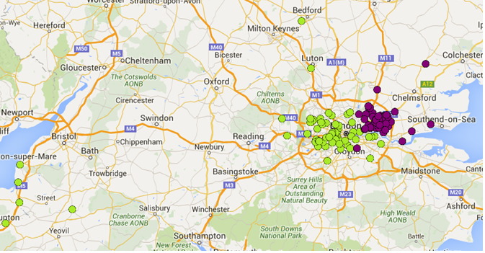
Distribution of respondents
It can be seen that visitors interviewed in Hammersmith Broadway (green dots) travel there from quite a broad swathe of West London, with significant numbers using the M4 corridor to arrive in Hammersmith. It appears that the Hammersmith posting has delivered a wide geographical reach
Hammersmith
Romford

Slide 5
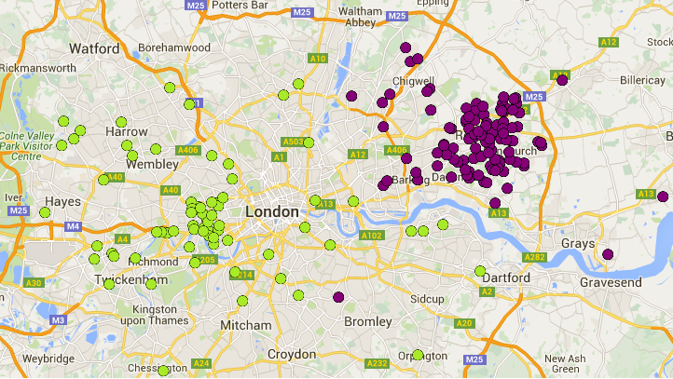
Distribution of Respondents
Visitors to the Liberty Centre, Romford (purple dots) are seen to come almost entirely from the immediate catchment, with just a handful coming from towns and villages within 30 minutes travel time
Hammersmith
Romford

Slide 6
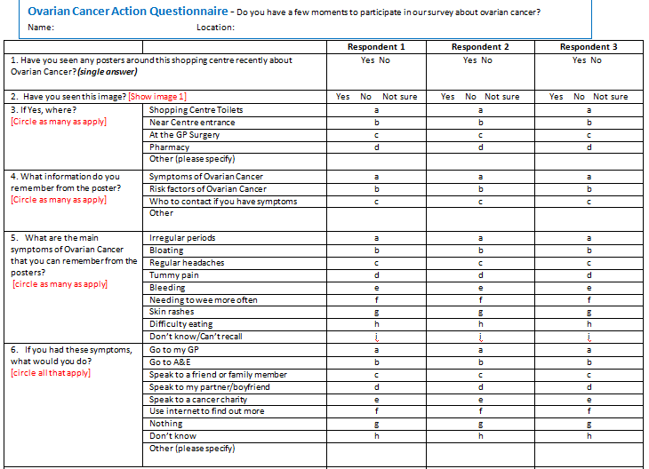
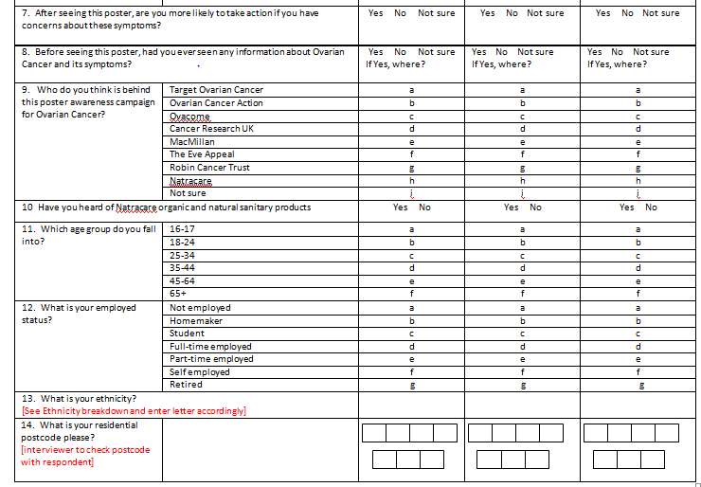
Ovarian Cancer Action :
Survey of Washroom
Campaign

Slide 7
Profile of Washroom Visitors

Slide 8
Age profile
The Hammersmith profile is rich in young professionals working locally and travelling through the centre, with the age range 25 to 44 contributing almost half of visitors. Romford shows a much more mature profile, with almost half aged over 45, including a quarter over 65
Q11. Which age group do you fall into?
Base: 218

Slide 9
Employed Status
The age range is also reflected in the employment profile. Hammersmith shows a large proportion of students, with 1 in 5 identifying with that status, and more than 1 in 7 ‘not employed’. In Romford retired folk outnumber those in full time employment, and less than 1 in 10 is a student.
Q12. What is your employment status?
Base:217

Slide 10
Ethnicity profile
By approaching participants on a ‘next available’ basis our approach aims to replicate the overall visitor profile. It can be seen that Hammersmith offers an ethnically mixed profile with almost 1 in 5 identifying as from an Asian ethnicity. Romford on the other hand presents a solidly white profile, with only 1 in 7 from all other ethnicities combined.
Q13. What is your ethnicity?
Base: 110

Slide 11
Ovarian Cancer Action Campaign :
Awareness and understanding

Slide 12
Awareness of Ovarian Cancer Campaign at key centres
Considering the scale of this campaign, awareness at both centres is very high, suggesting that both poster and posting location have been effective. In Romford almost half of washroom users are aware, reflecting partly the higher frequency of visiting a neighbourhood centre as opposed to the transient Hammersmith population.
Q1. Have you seen any posters around this shopping centre recently about Ovarian Cancer?
Base: 219

Slide 13
Recall of campaign imagery
When prompted by being shown the poster, awareness rises a little, by rather less than we would expect, suggesting this is a poster treatment that communicates and generates recall instantly
Q2. Have you seen this image?
Base: 220

Slide 14
Recall of campaign features
The washroom campaign is delivering strong recall of key messages, with a markedly higher recall of symptoms from respondents who have seen the poster in the washroom locations
Q4. What information do you remember from the poster? (Multiple response)
Base: 217

Slide 15
Recall of symptoms
The poster effectively communicates potential symptoms in a memorable way. Three of the five symptoms communicated are recalled by 1 in 5 visitors or more. Our options included three plausible but incorrect symptoms, and all three together achieve only 10% ‘recall’
Q5. What are the main symptoms of Ovarian Cancer that you can remember from the posters?
Base: 436 (all responses, multiple responses)

Slide 16
Recall of campaign locations
Although the campaign was appearing at various other locations during fieldwork, these washroom locations were by far the most memorable for these visitors. Given the context the recall of pharmacy locations is surprisingly low
Q3. If Yes, where? (Multiple response)
Base: 115

Slide 17
Call to action
Of our sample only 1 in 100 would now ignore potential symptoms of Ovarian Cancer, and well over half would take the most effective route and seek medical attention. This seems most strongly observed by those who noticed the poster in the washrooms, indicating the appropriateness of the location.
Q6. If you had these symptoms, what would you do? (Multiple Response)
Base: 217

Slide 18
Propensity to act
The campaign is successful in prompting action as well as recall, with 3/4 saying they are now more likely to take action, after seeing the poster
Q7. After seeing this poster, are you more likely to take action if you have concerns about these symptoms?
Base: 219

Slide 19
Inherited knowledge of Ovarian Cancer and symptoms
Exactly half of respondents had some prior knowledge of Ovarian cancer and its symptoms, with medical sources such as GP’s and hospitals providing most knowledge.
Q8. Before seeing this poster, have you ever seen any information about Ovarian Cancer and its symptoms? (If yes, where?)
Base: 218; / 101

Slide 20
Perception of campaign promoters
Two thirds of visitors believe they do know the organisations behind the campaign. But of those half (ie one third of respondents) cite the most visible brand in the sector. The town centre fieldwork location will also prompt this response, as visitors are familiar with seeing Cancer Research collectors in the town
Q9. Who do you think is behind this awareness campaign for Ovarian Cancer?
Base: 234

Slide 21
Awareness of Natracare
Natracare is not a heavily promoted brand and we imagine10% awareness among this sample is strong
Q10. Have you heard of Natracare organic and natural sanitary products?
Base: 216

Slide 22
Ovarian Cancer Action Campaign–
Headlines and recommendations

Slide 23
Ovarian Cancer Action – Headlines and recommendations
Our observations are based on analysis of survey data from interviews with a total of 219 females exiting washrooms in the Hammersmith Broadway centre, also in the Liberty Centre, Romford.
Of the two locations evaluated, Hammersmith Broadway delivered wider geographical reach. The Liberty centre on the other hand delivers an almost entirely local clientele. Awareness of both the campaign and the posters themselves is higher in Romford, where most visitors are from nearby.
The washroom is an effective location for the posters, which is likely due to the ‘captive’ audience (78% of respondents recalled seeing the poster in the washroom) and the appropriateness of the location
Overall, the campaign has been successful in influencing people to act on potential symptoms of ovarian cancer (79% of respondents would take action after seeing the poster).

Slide 24
Ovarian Cancer Action – understanding effectiveness of washroom campaign November 2015
Shoreditch Stables
138 Kingsland Road
London E2 8DY
info@roiteam.co.uk
www.roiteam.co.uk

